Slide 1



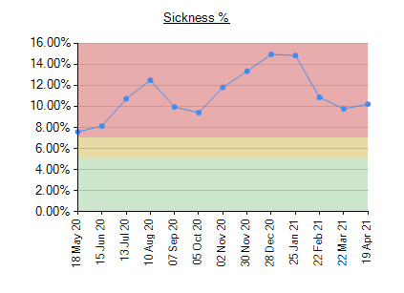
L
Kerensa Davies
Sister
Royal Preston Hospital Critical Care Unit
A QI Project that will introduce the Role of the PNA to CRCU, who will instigate restorative Supervision sessions to staff along with a self-help poster
H14320 – Professional Nurse Advocate
The professional nurse advocate (PNA) is someone who has undertaken additional training, enabling them to provide restorative supervision based on the AEQUIP model.
S - By introducing restorative supervision within critical care and the production of a self-help poster, the aim is to reduce sickness by 10% within 6 months
M –Sickness is recorded in accordance with trust guidelines, any reduction will be easily identified.
A – A 10% reduction equates to a potential saving of £4800 per month
R – Reasons for staff being off sick are multi-faceted, whilst the target is currently 4% it was May 2019 when this target was last reached – therefore a 10% reduction is achievable
T – Rates will be reviewed 6 months after the interventions have been implemented.
Critically evaluate how the professional advocacy role influences the provision of a high-quality service and can enhance compassion within the workplace.
The Courage of Compassion – Autonomy Belonging Contribution
May 2021 says The role out of the PNA will be implemented and they will use their skills to facilitate restorative supervision to their colleagues. PNA ‘s will listen and understand challenges and demands of fellow colleagues, they will lead, support and deliver quality improvement initiatives in response.
It is time to thank, repay and restore our people.
Critically reflect on the importance of collaborative working especially with other professional advocates and how this role will support governance and quality improvement frameworks to facilitate a positive culture of service improvement.
CQC key line of Enquiry; Are they caring? Are they responsive to peoples needs.
MNC Code of Conduct; Employer organisations should support their staff in upholding the standards
Lancashire Teaching Hospital Trust Values – Compassion, Empowered, Collaborative
Design a poster that will help identify how stress builds, what the signs are and where they can seek help it will also include tips on building resilience.
Critically explore how the professional advocate can support practitioners to develop self-awareness and to recognise enablers of good health and wellbeing that promotes the development of personal and team resilience across the workforce.
The PNA will benefit staff by ‘supporting them through a continuous improvement process that aims the build personal and professional resilience, enhance quality of care.’
They will provide; Supportive management, good leadership, staff training to recognise stress and to empower nurses to actively implement solutions.
Nurses who receive supervision; have improved capacity to think, reflect and cope
Organisational attachment - is a significant indicator of their capacity to remain resilient
Staff are empowered, revigorated, energised, these factors can lead to increased job satisfaction
Restorative supervision contains elements of psychological support including listening, supporting and challenging the supervisee to improve their capacity to cope, especially in managing difficult and stressful situations.
Dean W, Talbot S, Dean A.. Reframing clinician distress: moral injury not burnout. Fed Pract Health Pract. 2019;36(9):400–402. “Unscrambling what’s in your head”: A mixed method evaluation of clinical supervision for midwives (2017) B Love, M Sidebotham, J Fenwick, S Harvey, G Fairbrother 10.1016/j.wombi.2016.11.002 Women and Birth May, R. (21–02-05). Mrs. Nursing Times. https://www.nursingtimes.net/opinion/i-am-pleased-to-announce-the-roll-out-of-the-professional-nurse-advocate-programme-05-03-2021/ NHS England. A-EQUIP: A Model of Clinical Midwifery Supervision. London: NHS England; 2017 Nursing and Midwifery Council. The Code 2018. London: NMC; 2018 Wallbank S.(2010) Restorative Clinical Supervision Manual. NHS West Midlands Restorative Clinical Supervision Programme Wallbank S, Hatton S (2011) Reducing burnout and stress: the effectiveness of clinical supervision. Community Pract 84(7): 31–5 Elliott, V., & Wallbank, S. (2013). Giving something for me: Working with health visitors’ experiences of restorative supervision. Journal of Health Visiting, 1(7), 406–410.

