Slide 1
National Mentor Slides for those using the National Framework for Registered Nurse in Adult Critical Care

Slide 2
Introduction
This guide has been developed for mentors working in clinical practice who are mentoring staff using the National Competency Framework Step documents
It is designed to describe the important role mentors play in supporting staff to complete this process and provide some background and context to the use of the documents

Slide 3
Learning Objectives
On completion of this guide the learner should be able to:
Explain the background of the competencies
Define and describe competence
Discuss the role and responsibilities of the mentor
Discuss assessment and evidence
Explain the competency documents and their use
Consider action planning / failure to fail

Slide 4
Background
Following the demise of the ENB, critical care Nurse education went through a period of change which resulted in a very fragmented period resulting in disparate courses being run across the country with varying success for critical care
The Critical Care Lead Nurse Forum (CC3N) was formed and an educational “arm” of the group worked on producing Standards for Nurse Education in Critical Care…..

Slide 5

Background
The National Standards for Adult Critical Care Nurse Education launched in 2012 and updated in 2016

Slide 6


Slide 7

Background
The National Competency Framework for Registered Nurses in Adult Critical Care Step Competencies launched in 2012 and updated in 2015

Slide 8
What are the “Step” Documents?
Developed by key critical care stakeholders, including those from practice and academia
Created Core / essential system based competencies to mirror the core curriculum outlined in the National Standards for Critical Care Nurse Education
Standardised language and terminology used

Slide 9
What are Competencies
Competencies are statements describing behaviours that nurses believe are important for providing safe, effective and ethical care.
They reflect the practice expectations described in standards of practice and the professional attributes required in a given nursing role, situation or practice setting

Slide 10
What is Competence?
Competence is …..”The combination of skills, knowledge and attitudes, values and technical abilities that underpin safe and effective critical care nursing care and interventions”
The National Standards for Critical Care Education (2016)

Slide 11
Cycle of Competence
Unconsciously unskilled
Consciously unskilled
Consciously skilled
Unconsciously
skilled

Slide 12
Principles of Implementation
New staff member – complete mandatory training
Commence Step 1 competencies during supernumerary period
National Competency Framework for Critical Care Nurses (2015)
Steps 2 & 3 Competencies
Delivered by expert Critical Care
Work based standardised clinical assessment
Ready to commence Academic Programme
Work with Mentor/s to achieve competencies
Successful completion of academic competencies
National Standards for Critical Care Nurse Education (2016)
60 Credits Level 6 or level 7
Successful completion of academic programme
Core Curriculum Assessments – exams, viva’s
Validated and transferable Critical Care Award
Notes:
Query this slide as they no longer complete academic competencies it is step 2 & 3

Slide 13
Step One
Step 1 competencies
  Should be commenced when a nurse begins in critical care where he/she has no previous experience of the speciality. These competencies can aid staff development during preceptorship. It would generally be expected that staff will have completed Step 1 competencies before accessing an academic critical care programme.
  Step 1 competencies assess essential knowledge and skills and should be completed within a 12-18 month timeframe
Notes:
Local Organisations and HEI’s/Providers of acute care courses may use their discretion as to whether Step 1 competencies are relevant and transferable to Level 1 enhanced care areas and/or Critical Care Outreach teams.

Slide 14
Step 2
Steps 2 & 3 competencies should be completed during the period of an academic critical care programme where ‘the learner’ will gain the necessary depth of related theory and knowledge.
Step 2 competency will allow the nurse to:
  Demonstrate skilled performance in the activity with enhanced theoretical knowledge and understanding giving rationale for practice
  Demonstrate application of knowledge and understanding in relation to relevant policies, procedures and guidelines
  Participate in problem solving through critical analysis and evaluation of more complex situations
  Develop more varied critical care experience with minimum supervision and guidance, attaining competence in related knowledge and skills

Slide 15
Step 3
Steps 2 & 3 competencies should be completed during the period of an academic critical care programme where ‘the learner’ will gain the necessary depth of related theory and knowledge.
Step 3 competency will allow the nurse to:
  Demonstrate competent performance in all the activities specified without direct supervision based upon relevant evidenced based knowledge, intuition and established practice
  Independently problem solve complex situations and offer solutions through critical analysis and evaluation
  Supervise and instruct others in a range of activities related to their role and responsibilities
  Apply knowledge, understanding and research to relevant policies, procedures and guidelines to critically analyse and improve practice

Slide 16
Adding Competencies
It is important to complete 100% of the competencies in all Steps of competence for a standardised approach and ensure transferability
Although competencies cannot be removed from the framework local organisations may add additional competencies to cover more specialist care pertinent to their own area, for example, cardiothoracic, major trauma, burns and neurology.
The National Working Group are working on “Specialist Competencies” which will be available on the CC3N website when complete

Slide 17
Key Principles
For the competency document to remain valid and transferable between organisations and geographical areas, 100% of competencies need to be achieved
If competencies are not achievable within the normal working environment, systems should be put in place that allow staff to gain exposure and experience in the outstanding core competencies within other departments and/or critical care units
A lack of learning opportunities locally should not prevent an individual learner from progressing through the competencies

Slide 18
Essential Best Practice Principles
Supernumerary time
Learner / mentor clinical time
Creative Learning Environment
Clinical placement
Quality assurance
Designated Practice Educator
Learning contract
Notes:
Learning contract –
Required between the individual learner, lead assessor and unit manager before undertaking the programme
Designated practice educator –
Designated practice educator to support implementation of competencies and lead in development
Supernumerary study time –
Minimum 4-6 weeks and protected study time for formal educational programmes
Learner and mentor clinical time –
Facilitate 40% of learners clinical practice house mentor / assessor / practice educator / or delegated other
Creative environment for learning –
Provide a range of learning experiences, involving patients, professional team members
Clinical placement –
Provide clinical placements to facilitate learner development and achievement of clinical outcomes
Mentor and assessor quality assurance –
Regulation and quality assurance of mentors to ensure validity and transferability of the assessment process

Slide 19
Essential Best Practice Principles
Learning Contract: The signing of the learning contract is essential so all responsible parties commit to the process
Designated Practice Educator A designated critical care Practice Educator (or equivalent) is essential to support and monitor the progress of the process
Supernumerary Study Time Provide a minimum supernumerary period of 6-8 weeks for newly appointed registered nurses
Notes:
Learning Contract A learning contract is required between the individual learner, lead assessor and unit manager before undertaking the competency programme
Designated Practice Educator A designated critical care Practice Educator (or equivalent) is required to support the implementation of the competencies in practice and lead in the development and implementation of the adopted critical care education strategy
Supernumerary Study Time Provide a minimum supernumerary period of 6-8 weeks for newly appointed registered nurses and support protected study leave for formal educational programmes, as and when required

Slide 20
Essential Best Practice Principles
Learner and Mentor Clinical Time – this should be protected and prioritised
A creative environment for learning – the practice educator and senior nursing team are required to promote learning by creating a positive and nurturing learning environment
Clinical Placement -Provide and/or support clinical placements to facilitate learner development
Mentors and Assessors Quality Assurance- this requires support and managing by the practice educator and senior nursing team
Notes:
Learner and Mentor Clinical Time Facilitate a minimum of 40% of learners’ clinical practice hours with their mentor/assessor/Practice Educator, or other designated appropriate other
A creative environment for learning Provide a range of learning experiences, involving patients, clients and professional team members to meet the defined learning needs of the workforce
Clinical Placement Provide and/or support clinical placements to facilitate learner development and achievement of clinical outcomes and core/essential competency requirements
Mentors and Assessors Quality Assurance Regulation and quality assurance of mentors and assessors should be undertaken by local organisations, HEI’s and critical care Practice Educators, to ensure validity and transferability of the nurses’ competency

Slide 21
Roles and Responsibilities of the Mentor
Mentor Criteria
Specific Responsibilities
Effective working relationships
Facilitate learning
Provide leadership
Complete Documentation

Slide 22
Role and Responsibility of the Mentor
To adhere to the National Standards for Adult Critical Care Nurse Education, mentors must meet the following criteria:
Complete an NMC approved mentor preparation programme and meet the standards of regulatory bodies
Be approved by managers and supported by organisations to undertake mentorship and assessment roles
Provide constructive feedback to learners and support the identification and development of learning needs and action plans
Demonstrate on-going professional development / competency within critical care
Manage and support failing learners so that they may enhance their performance and capability for safe and effective practice
Notes:
Mentor / Assessor Responsibilities
Demonstrate a breadth of understanding in assessment strategies and the ability to contribute to the total assessment process as part of the teaching team
Provide constructive feedback to learners and assist them in identifying future learning needs and actions
Identify failing learners so that they may enhance their performance and capabilities for safe and effective practice or be able to understand their failure and the implications of this for their future
Accountable for confirming that learners have met, or not met, the critical care competency statements and are capable of safe and effective practice at the relevant level
Demonstrate a working knowledge of current educational programmes, practice assessment strategies and relevant changes in education and practice for the learner they are assessing
Demonstration of an in depth understanding of their accountability for the decision they make to pass or fail a learner when assessing competency
Mentors/Assessors must meet the following requirements:
Complete an NMC approved mentor preparation programme
Comply with the NMC Mentorship Standards
Perform all clinical skills in a professional, safe and consistent manner
Demonstrate evidence of developing their knowledge skills and competence beyond their nursing registration
Have completed a post registration qualification in critical care nursing
Demonstrate that their practice is evidenced based and in line with current critical care recommendations and guidelines
Is able to make recommendations in relation to competence and provide rationale
Is approved by the Critical Care Service Manager/Lead Nurse

Slide 23
Role and Responsibility of the Mentor
Specific responsibilities of mentors include:
Promote a positive learning environment
Bring to the attention of the Practice Educator and / or Manager concerns related to the individual nurses learning and development
Support the individual to expand their knowledge and understanding
Highlight and prioritise learning opportunities
Set realistic and achievable action plans Complete assessments within the recommended timeframe

Slide 24
Role and Responsibility of the Mentor
To establish effective working relationships by:
Demonstrating an understanding that influence how individuals integrate into practice
Provide on-going constructive support to facilitate transition from one learning environment to another
Demonstrate effective professional and inter-professional working relationships to support learning

Slide 25
Role and Responsibility of the Mentor
To facilitate learning by:
Using knowledge of the learners stage of development to select appropriate learning opportunities to meet the individuals needs
Facilitating the selection of appropriate learning strategies to integrate learning from practice and academic experiences
Supporting learners in critically reflecting on their learning experiences in order to enhance future learning
Identifying and applying research and evidence based practice to their area of practice
Supporting learners in applying an evidence base to their own practice

Slide 26
Role and Responsibility of the Mentor
To provide leadership by:
Planning a series of learning experiences that will meet learners defined learning needs
Acting as an advocate for learners to support them accessing learning opportunities that meet their individual needs
Prioritise work to accommodate support of learners within their practice roles
Provide feedback about the effectiveness of learning and assessing in practice

Slide 27
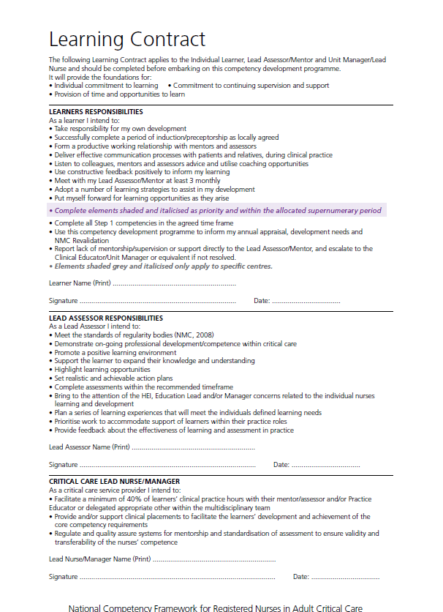
How to complete the documents
The Learning Contract appears in all three documents and must be signed by
The Learner
The Lead Assessor (this could be you within your mentoring role)
The Critical Care Lead Nurse or Manager
This contract clearly states each of the responsibilities of the above
This must be completed prior to submission of the document

Slide 28

How to complete the documents
The Authorised Signature Record must be completed by any individual who is making an entry into the competency document.
This provides clear documentation on submission to check the mentors are fully registered and meeting MMU regulations.

Slide 29
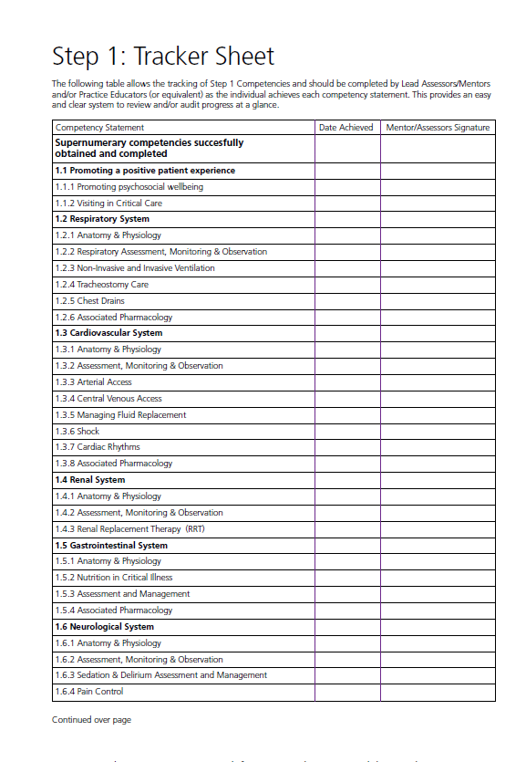
How to complete the documents
25.05.16
A.Mentor
Tracker Sheet’s feature in all three of the documents. They offer a quick reference point to review the learners progression
On successful completion of each Competency Statement in full, the tracker sheet should be completed
Each competency needs to be signed individually – NO brackets
25.05.16
A.Mentor

Slide 30
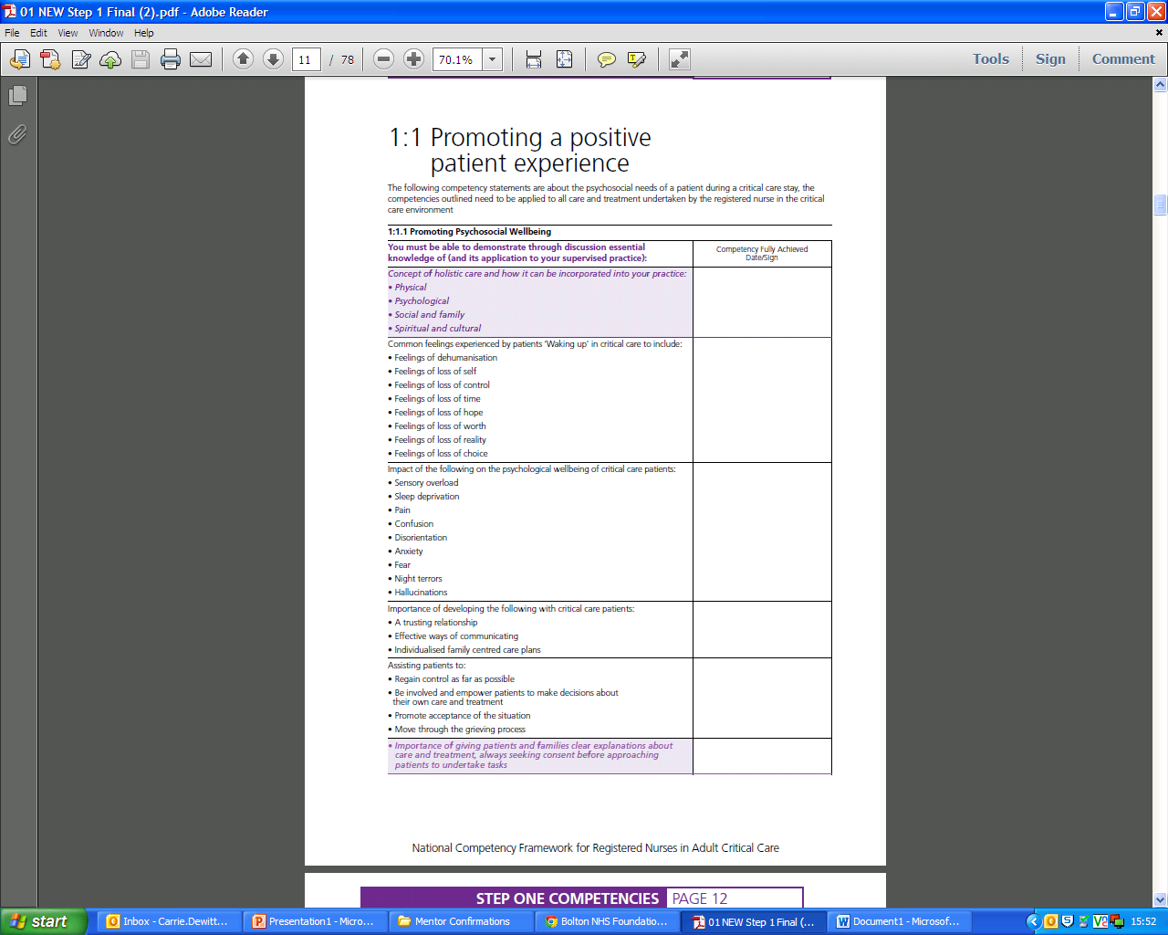
How to complete the documents
Competency Statement’s in all the documents state competency elements which need to be assessed and achieved in practice
You may achieve these in a variety of ways including,
  Simulation
  Written work
  Discussion and probing questions
  Observation in practice
If a learner is not competent at the time of assessment an Action Plan should be devised to support achievement
There can be brackets on these competency assessments
A.Mentor
25.5.16
A.Mentor
25.5.16

Slide 31
How to complete the documents: Step One only
Some elements of the competency statements in the Step One Document are shaded purple. These should be completed within the supernumerary period and can form part of the local induction process
These competencies can be signed using brackets when achieved.
A.Mentor
25.5.16
A.Mentor
25.5.16

Slide 32
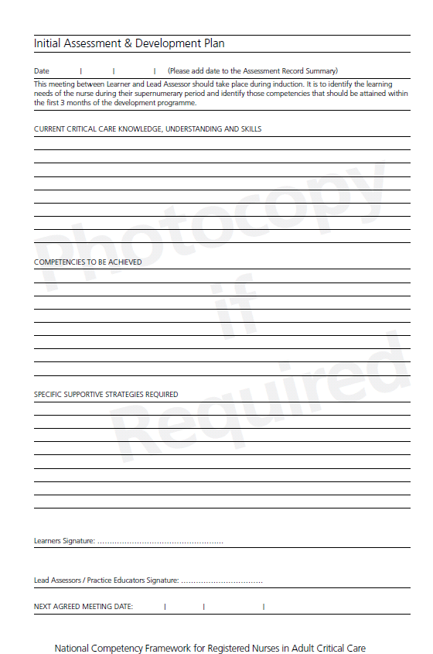
How to complete the documents
Initial Assessment and Development Plan are found in Step One, Two and Three Documents
The Learner should meet with a mentor to establish their current level of understanding and experiences
This should then prompt the production of action plans to support the development of the learner
This should be signed by the mentor and the learner along with a date for the next meeting
Learner
Mentor
Date

Slide 33
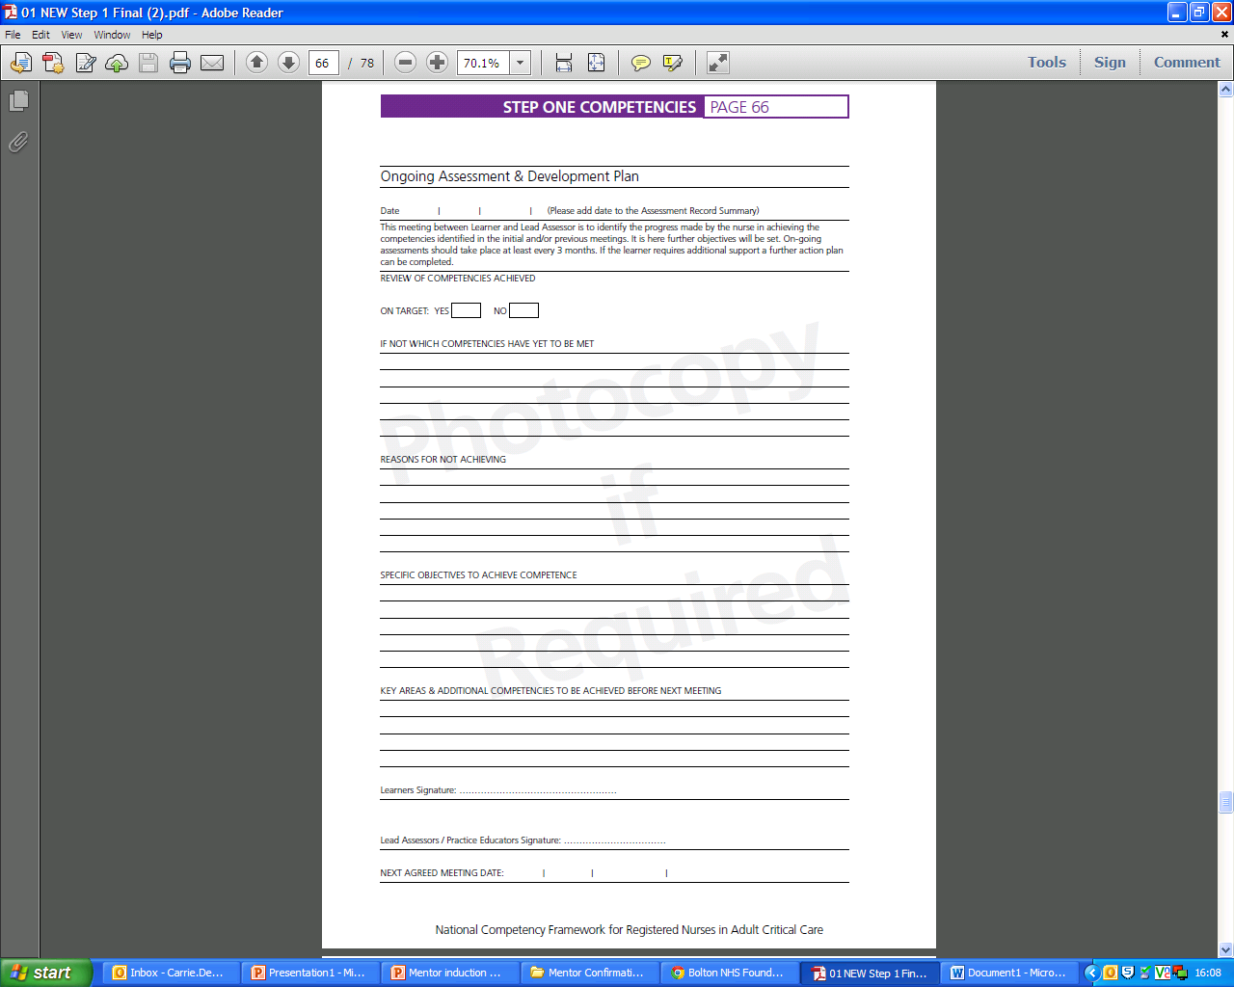
How to complete the documents
On-going Assessment and Development Plans are found all the Step Documents
The Learner should meet with a mentor to identify progress made in achievement of competencies, at least 3 monthly with the Step One document. These meetings will be more frequent with the Step Two and Three Documents given the six month time frame for completion
Further action plans should be developed from these meetings to support achievement
This should be signed by the mentor and the learner along with a date for the next meeting
Learner
Mentor
Date
Mentor
Learner

Slide 34

How to complete the documents
Additional Action Planning forms are found all the Step Documents and can be photocopied as required
These should be utilised to set SMART objectives to meet the identified competencies from the previous conversations and documentation
This should be signed by the mentor and the learner along with a date for the next meeting
Learner
Mentor
Date
Learner

Slide 35
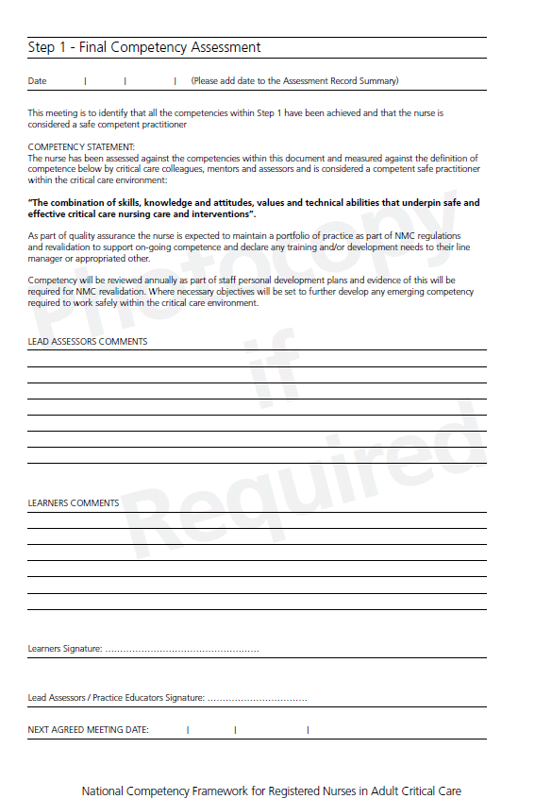
How to complete the documents
Final Competency Assessment’s are found all the Step Documents
These should be completed by the mentor and the learner to reflect upon the achievement of all the competencies and any issues encountered
On-going progression can be documented here
This should be signed by the mentor and the learner along with a date for the next meeting. The next meeting could be the review of maintaining of competencies at appraisal
Learner
Mentor
Date
Learner

Slide 36

How to complete the documents
Annual Competency Assessment’s are found all the Step Documents
These can be utilised at appraisal to demonstrate maintaining competency in all areas
Action plans can be developed from this
In relation to the Critical Care Programme, this is not required to be completed prior to submission
Learner
Mentor
Date
Learner

Slide 37

Assessment and Evidence
Simulation
Record of achievements
Discussion and questions
Workbooks
Reflective practice
Portfolio

Slide 39
Assessment Methods
Direct observation
Simulation - best for skills assessment
Discussion and probing questioning
Written work - best for knowledge assessment
Reflection/ witness testimonials
39

Slide 40


Slide 41
To Conclude….
The competency framework should be used in conjunction the National Standards for Critical Care Nurse Education and aims to:
Provide clarity for organisations and describes what they can expect a competent critical care nurses to do within their role
Reduce variations in assessment of nurse competence across the critical care community
Provide a standardised approach to the competency assessment of critical care nurses undergoing post registration academic programmes of study
Provide a currency that allows recognition of competence between health care organisations

Slide 43
References
Faculty of Intensive Care Medicine, Intensive Care Society (2015) Guidelines for the Provision of Intensive Care Services. 1st Edition. Joint standards committee. FICM, ICS
Faculty of Intensive Care Medicine, Intensive Care Society (2013) Core Standards for ICU. 1st Edition. Core standards working party. FICM, ICS
National Competency Framework for Adult Critical Care Nurses (2015) Critical Care Nurse Education Review Forum on behalf of the Critical Care National Network Lead Nurse Forum (CC3N)
National Standards for Critical Care Nurse Education: A framework to improve educational outcomes and quality (2012) Critical Care Nurse Education Review Forum on behalf of the Critical Care National Network Lead Nurse Forum (CC3N)
NMC Mentorship (2008) Standards to support learning and assessment in practice. NMC standards for mentors practice teachers and teachers.

